Slide 1
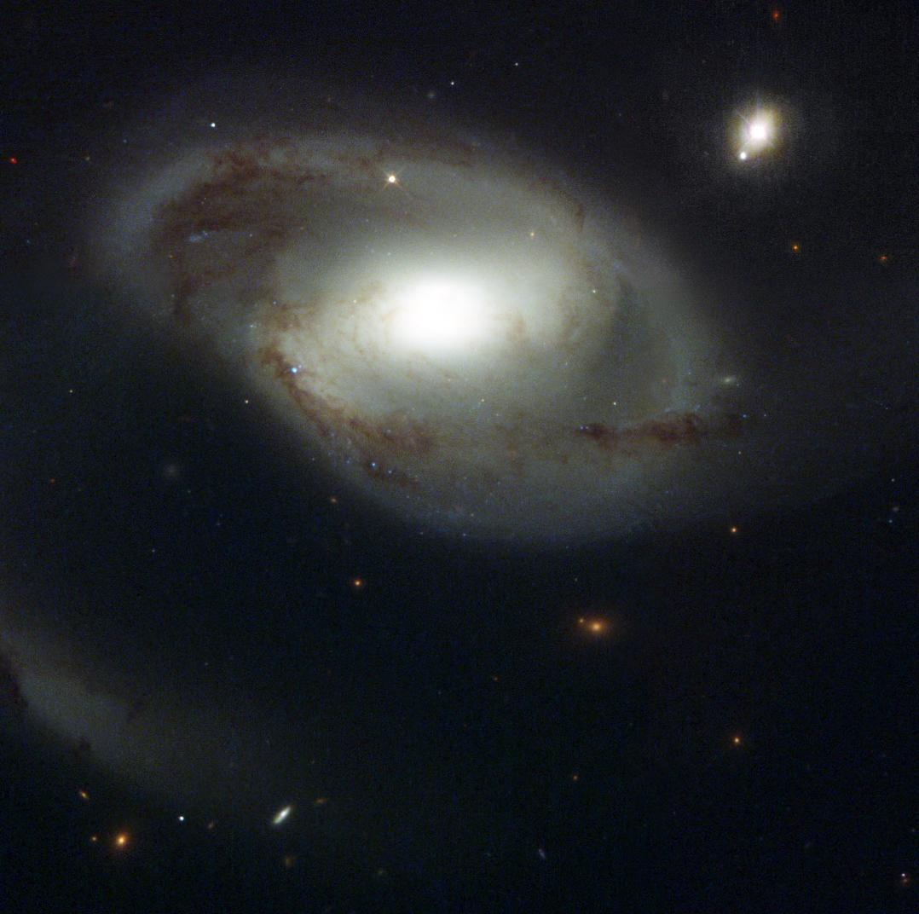
Does the gas in the IGM care about galaxies?
Tracing the Circumgalactic Medium in Lyα with COS
David M. French
Thesis Advisor: Bart Wakker
University of Wisconsin - Madison
Jan 11, 2018
Image Credit: NASA and The Hubble Heritage Team (STScI/AURA)

Slide 2
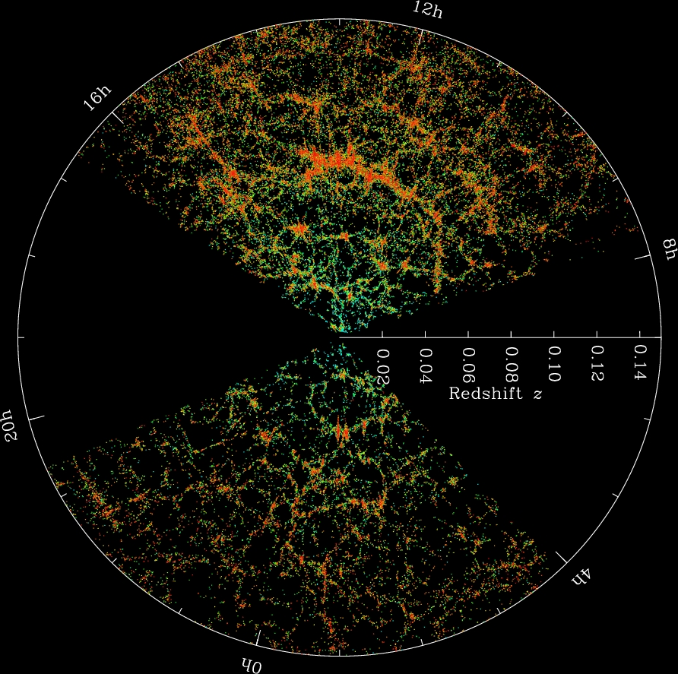
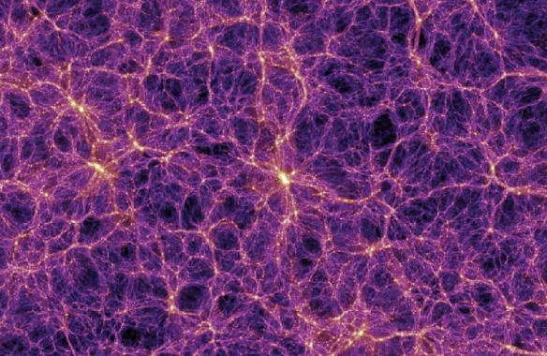
Gas in the Universe
The Millenium Simulation
SDSS Collaboration
Notes:
Gas collapsed with DM into filaments = cosmic web, formed galaxies

Slide 3
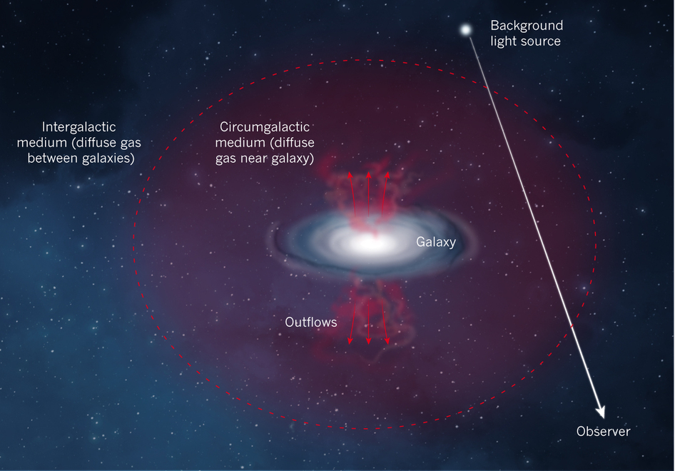
Defining the CGM
ΔV
Impact parameter (ρ)
Nature 517, 444
Notes:
Put one of these first

Slide 4
Understanding the CGM
Gas and galaxies follow the same DM potential
Galaxies need to continue accreting gas over cosmic time to match observations
Feedback kicks gas out of galaxies
How do the properties of gas correlate with nearby galaxy properties?

Slide 5
Science Outline
Use archival COS sightlines (~700)
- Find Lyα, associate with galaxy environment
Stay close (z < 0.034, cz < 10,000 km/s)
- Available galaxy data complete to ~0.2 L*
Automate associating galaxies – absorbers
Ask: absorber (EW, N(HI), velocity)
as a function of
galaxy (impact parameter, size, orientation)

Slide 6
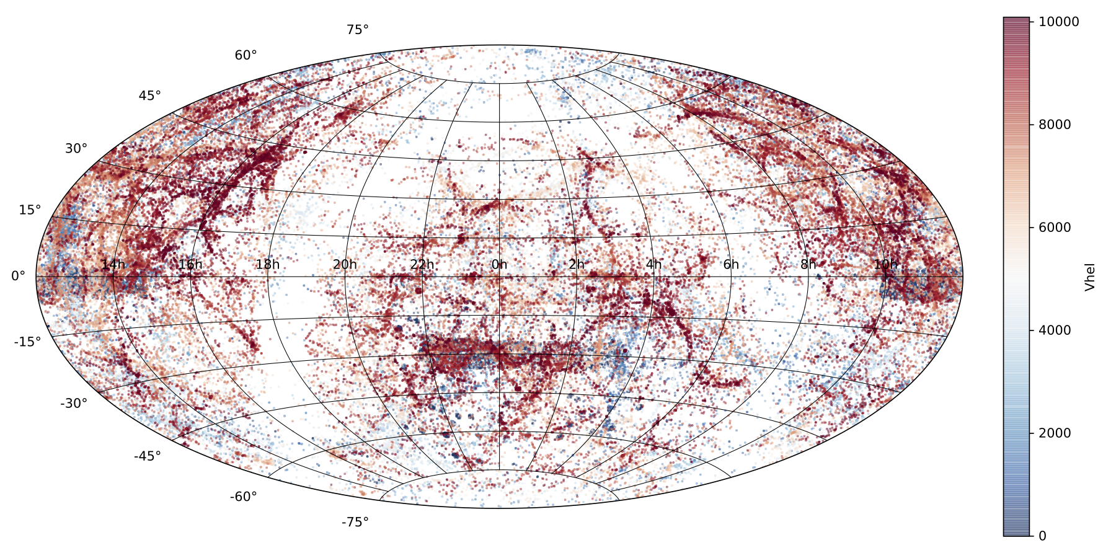
Step 1
Gather and homogenize existing galaxy data
NED + IRSA
130,000+ galaxies with cz < 10,000 km/s

Slide 7
Step 2
Objectively connecting absorbers with galaxies

Slide 8
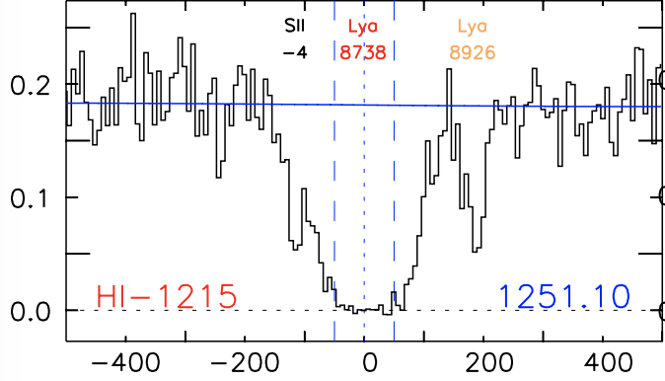
Step 2
Objectively connecting absorbers with galaxies

Slide 9
Step 2
Objectively connecting absorbers with galaxies
Define a likelihood:
= impact parameter
= viral radius of the galaxy

Slide 10
Step 2
Objectively connecting absorbers with galaxies
= 0.00027
= 0.16

Slide 11
Step 2
Equivalent width vs impact parameter

Slide 12
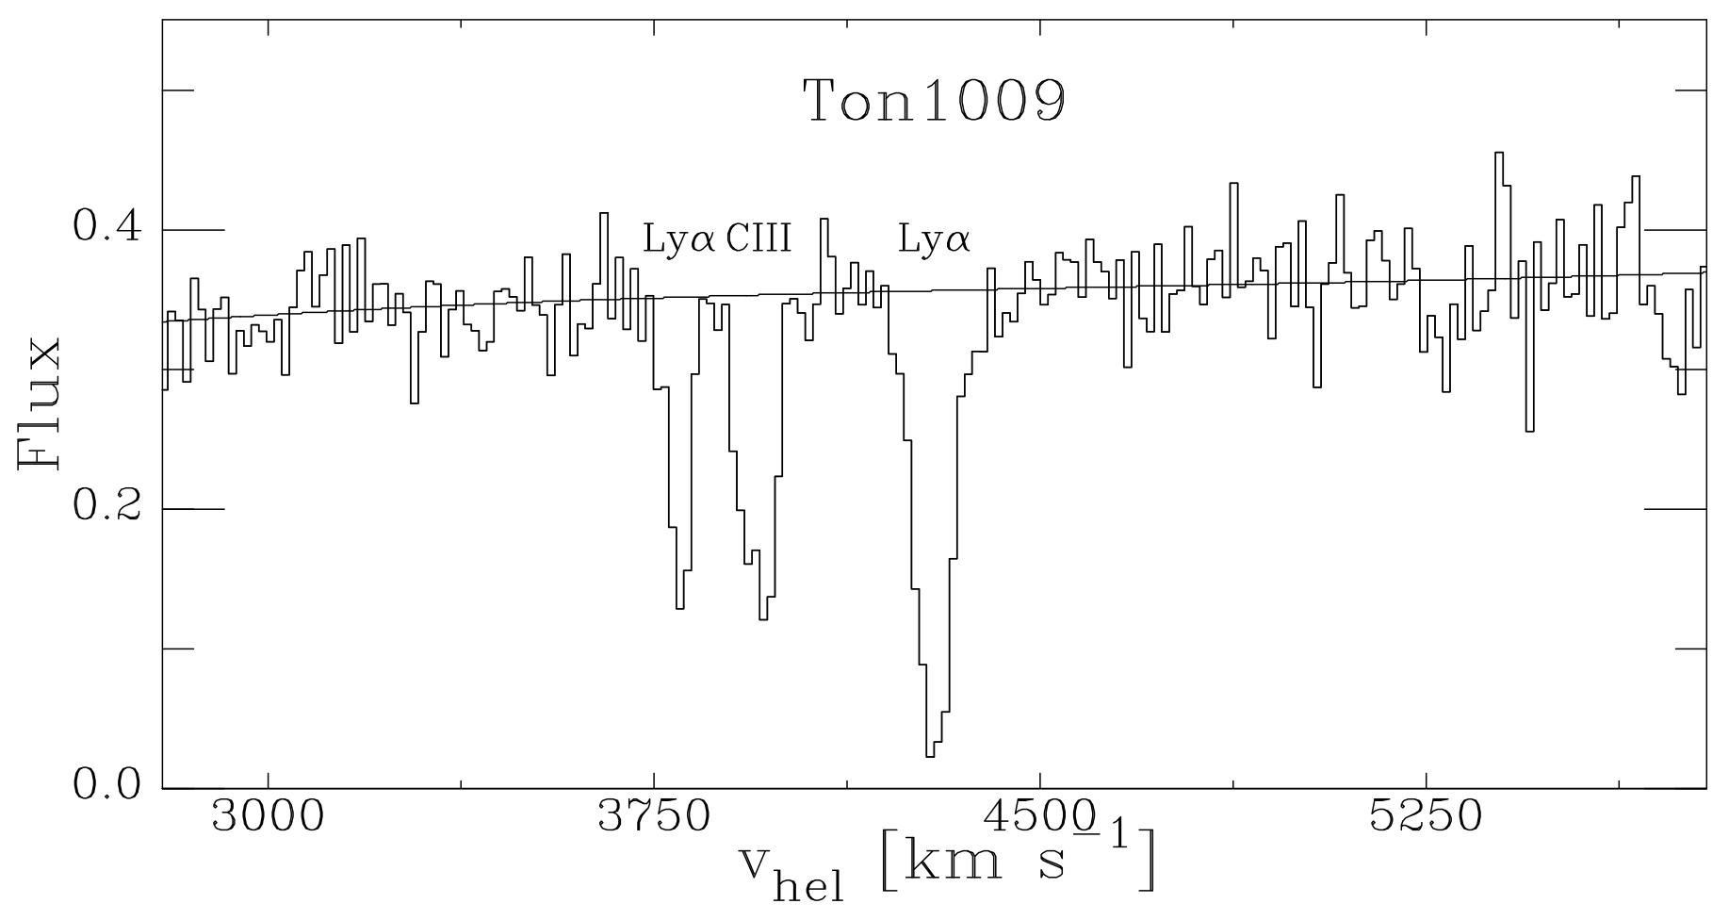
Associating galaxies with absorbers
Is this Lyα absorber associated with a galaxy?
Notes:
Define inclination and orientation

Slide 13
Associating galaxies with absorbers
Define a likelihood:
= impact parameter
= viral radius of the galaxy
Require and
Notes:
Define inclination and orientation

Slide 14
Associating galaxies with absorbers
L = 0.802
L = 0.062
Notes:
Define inclination and orientation

Slide 15
Results so far…
35 COS sightlines analyzed
175 Lyα lines
- 41 associated
- 44 ambiguous (no best match)
- 88 IGM (no galaxies nearby)
Notes:
Define inclination and orientation

Slide 16
Impact parameter
Notes:
Define inclination and orientation

Slide 17
Impact parameter /
Notes:
Define inclination and orientation

Slide 18
Impact parameter vs
Notes:
Define inclination and orientation

Slide 19
Impact parameter /
Most absorbers are found around
Notes:
Absorbers are found most commonly around impact/R = 1.25

Slide 20
EW vs Δv
Notes:
Median EW increases with decreasing velocity difference

Slide 21
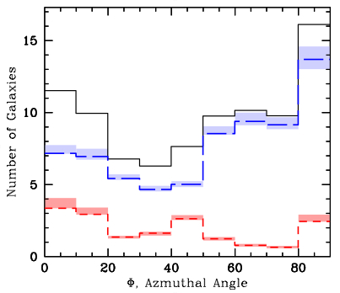
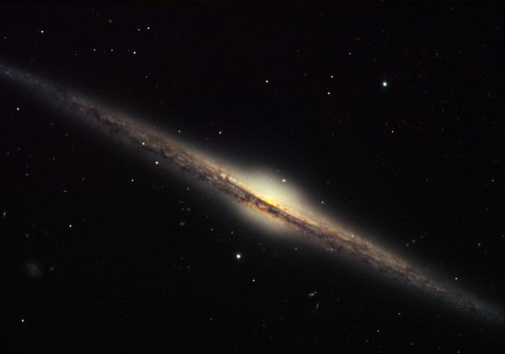
How do CGM absorber properties depend on galaxy orientation?
Major vs minor?
Same for neutral gas?
QSO
Credit: Bruce Hugo & Leslie Gaul, Adam Block, NOAO, AURA, NSF
Kacprzak et al. 2012

Slide 22
How do CGM absorber properties depend on galaxy orientation?
Lyα
MgII
Kacprzak et al. 2012

Slide 23
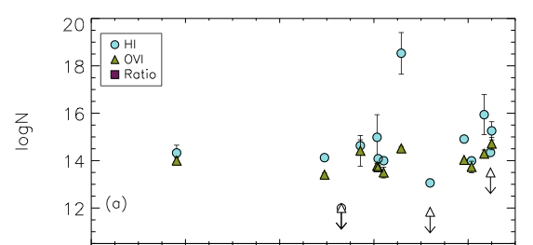
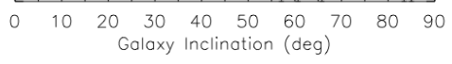
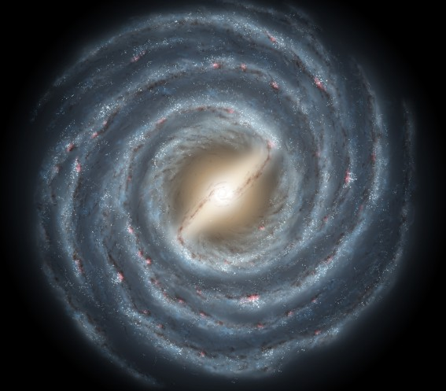
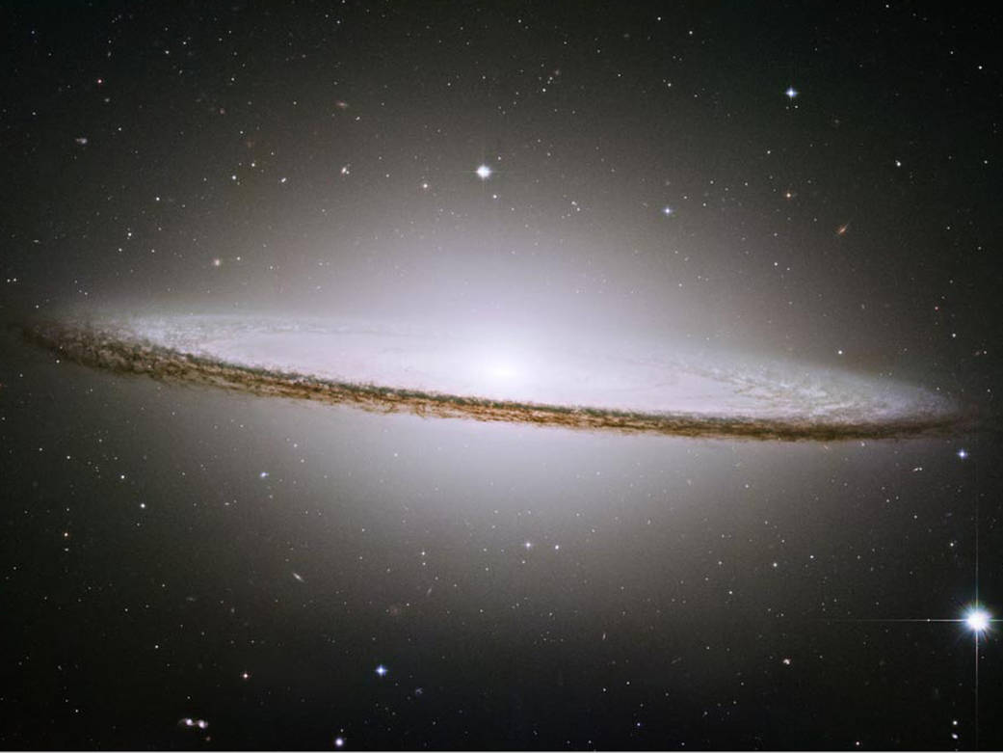
Galaxy Inclination
No?
Mathes et al. 2014
Notes:
TAKE OFF THE BOTTOM PART

Slide 24
Galaxy Inclination
Maybe?
Notes:
Slight increase in median EW with increasing inclination

Slide 25
Galaxy Inclination
Notes:
Slight increase in median EW with increasing inclination

Slide 26
EW dichotomy
Notes:
Slight increase in median EW with increasing inclination

Slide 27
EW dichotomy
Median EW(blueshifted) = 343 +/- 10 mÅ
Average = 353 +/- 12 mÅ
Median EW(redshifted) = 124+/- 9 mÅ
Average = 236 +/- 16 mÅ
The difference: KS p-value = 0.04
Why?
- Inflows/outflows?
- Rotation?
Notes:
Slight increase in median EW with increasing inclination

Slide 28
Summary:
Define likelihood – a reproducible method for associating absorption with nearby galaxies
EW – Impact parameter anti-correlation with
Absorbers most commonly found near ρ ~ 1.2
Median EW increases with decreasing Δv
Azimuth, inclination dependence is unclear
Absorbers are more common near highly inclined galaxies
Redshifted absorption weaker than blueshifted?
Questions?

Slide 29
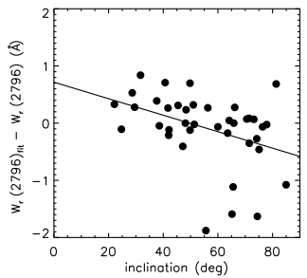
How do CGM gas properties depend on galaxy inclination?
Maybe?
MgII W (mÅ)
Kacprzak et al. 2011
Notes:
Kacprzak claims a correlation between inclination and equivalent width – halo gas has a co-planar geometry and is coupled to the disk inclination.
Y-axis: EW residuals computed from the fit between EW vs impact parameter
BLURRY

Slide 30
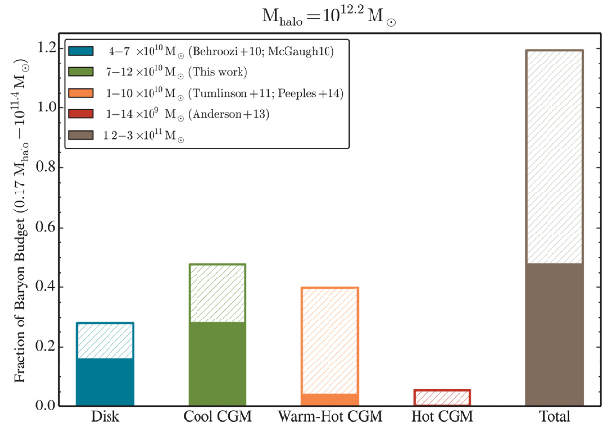
Baryon Budget
Werk et al. 2014, ApJ, 792, 128
Notes:
Green -> Lya (T = 10^4), Orange -> OVI (T = 10^5 – 10^7), Red -> X-rays (T>10^7)

Slide 31
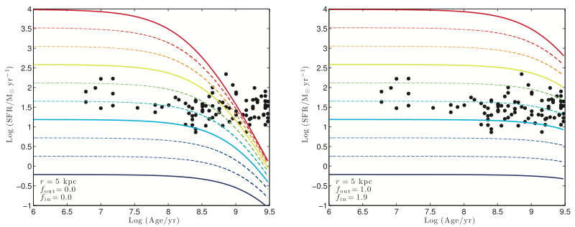
Accretion required
With no accretion
With accretion
SFR
SFR
AGE
AGE
Erb 2008
Notes:
LEFT: Closed box.
RIGHT: Outflow rate = SFR, inflow rate = 1.9*SFR

Slide 32
Associating galaxies with absorbers
Define a likelihood:
Notes:
Define inclination and orientation

Slide 33
How do CGM gas properties depend on galaxy orientation?
Kacprzak et al 2012 find bimodal MgII absorption
Blue = late type
Red = early type
QSO
Major axis
Minor axis
Credit: Bruce Hugo & Leslie Gaul, Adam Block, NOAO, AURA, NSF
Kacprzak et al. 2012
Notes:
Black is total, red is red galaxies (early type), blue is blue galaxies (late type)
LABEL ON THE PLOT “MINOR” AND “MAJOR” AXIS

Slide 34
The gas nearby galaxies
Gas and galaxies both follow DM potential
Do they “know” about each other?
- i.e. Do gas properties depend on galaxies?
Notes:
Gas and galaxies both follow the DM potential, but how do the interact?

